Slide 1
Programming JAVA {
Hiveed.java
ABSTRACTION;
/* Here is where your journey for your dream begins */
}
JAVA Programming

Slide 2
Hiveed.java
What is abstraction ? :
Telling what is necessary and hiding what is not necessary.
Hiding the internal implementation logic and show only the functionality is known as abstraction.
JAVA Programming

Slide 3
Hiveed.java
What is abstract method in java :
A method which does not have any implementation is known as abstract method.
The method should be prefixed with the abstract keyword at the starting and it should be end with the semicolon.
Method Syntax :
abstract void display( );
JAVA Programming

Slide 4
Hiveed.java
What is abstract class :
Any class which contains the abstract method then the class is called as Abstract method.
What is abstract class contains :
• Static variable
• Non static variable
• Static concrete method
• Non-static concrete method
• Constructor
• Abstract method
JAVA Programming

Slide 5
Hiveed.java
It is not possible to create the object for abstract class but we can create the reference variable of the abstract class.
Abstract class with respect to inheritance :
It is possible to achieve the inheritance for abstract class and concrete class.
Abstract class with respect to inheritance :
1. Make sub-class as abstract.
or
2. Override the abstract method.
JAVA Programming

Slide 6
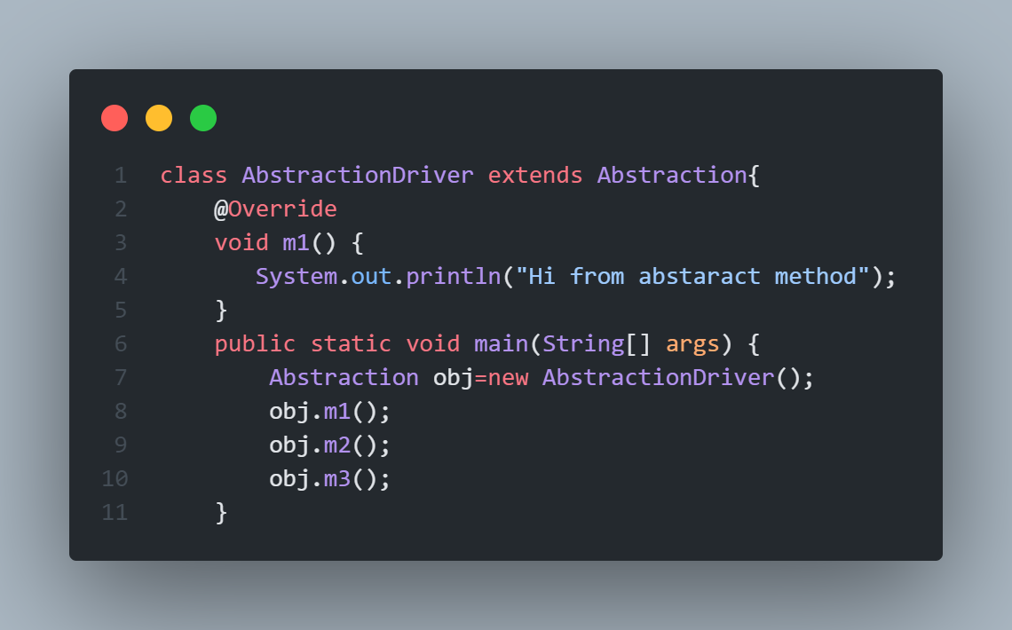
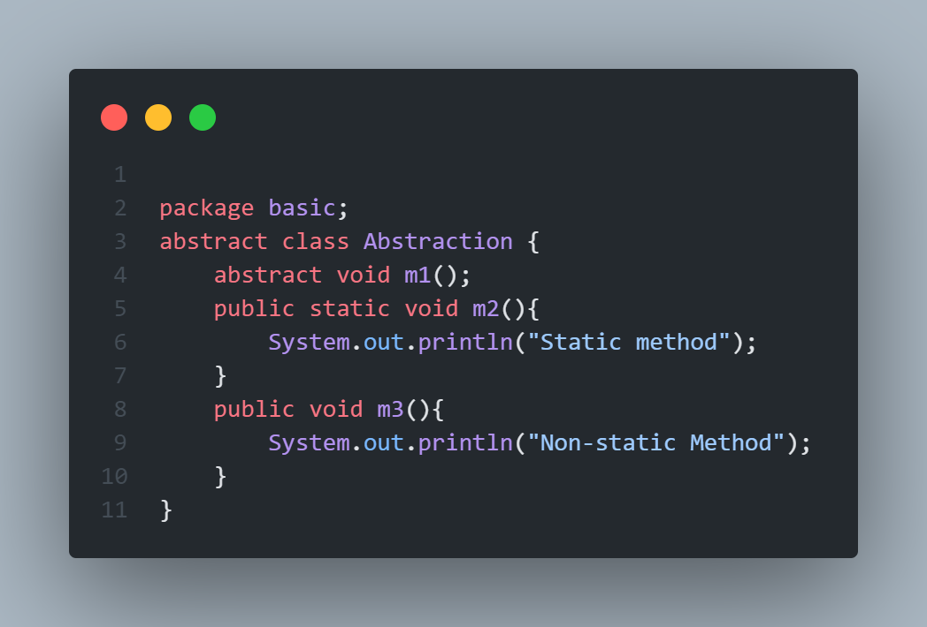
Hiveed.java
EXAMPLE :
JAVA Programming

Slide 7
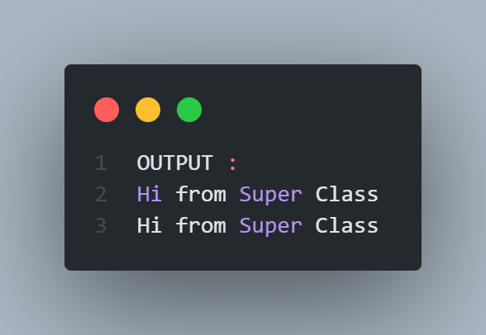
Hiveed.java
OUTPUT :
JAVA Programming

Slide 8
Hiveed.java
JAVA Programming

